Slide 1
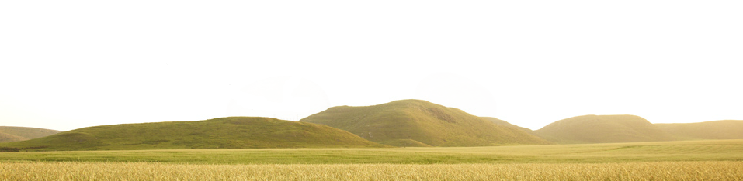
Walking Together
First Nations, Métis and Inuit Perspectives in Curriculum
A Professional Development Resource
Notes:
This resource is response to calls for support in weaving First Nation, Métis and Inuit content, perspectives and experiences into the Alberta curriculum.
This resource is intended to be used by teachers, administrators, parents/guardians, and stakeholders in enhancing their knowledge and understanding of First Nation, Métis and Inuit content, perspectives and experiences.

Slide 2
Walking Together
First Nations, Métis and Inuit Perspectives in Curriculum
Backgrounder
Notes:
This resource will provide a working foundation of First Nation, Métis and Inuit topics, issues, cultures and ways of knowing.
Throughout the resource are personally meaningful perspectives and experiences from members of various First Nation, Métis and Inuit communities across Alberta.
The contributing members truly wanted to share their knowledge, experiences and wisdom in a spirit of enhancing the education of their children and grandchildren.
However, it is important to point out that the weaving of First Nation, Métis and Inuit content, perspectives and experiences into learning experiences is intended to enhance the education of ALL children in Alberta.

Slide 3

The Focus
What?
How?
Why?
Who?
Notes:
While we journey through this presentation together, the following questions will guide us:
Why does understanding our First Nations, Métis and Inuit populations matter?
Who is the intended learning audience for this resource?
How is this resource authentic, appropriate and accurate?
What is in this resource?

Slide 4
FIRST NATIONS, METIS AND INUIT STUDENT POPULATION MATTERS
Why understanding our
Notes:
Questions such as “Why is there such a focus on First Nations, Métis and Inuit student populations?” are asked all over the province. The next few slides will help us answer that very question.

Slide 5
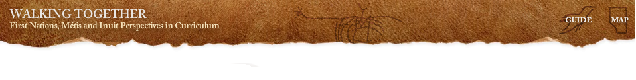
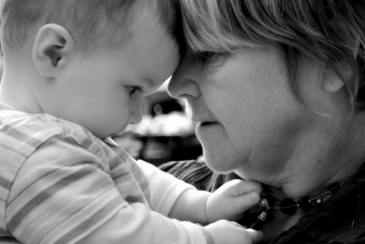
3X
Notes:
Our Aboriginal or indigenous population is growing at three times the rate of non-Aboriginal population.

Slide 6
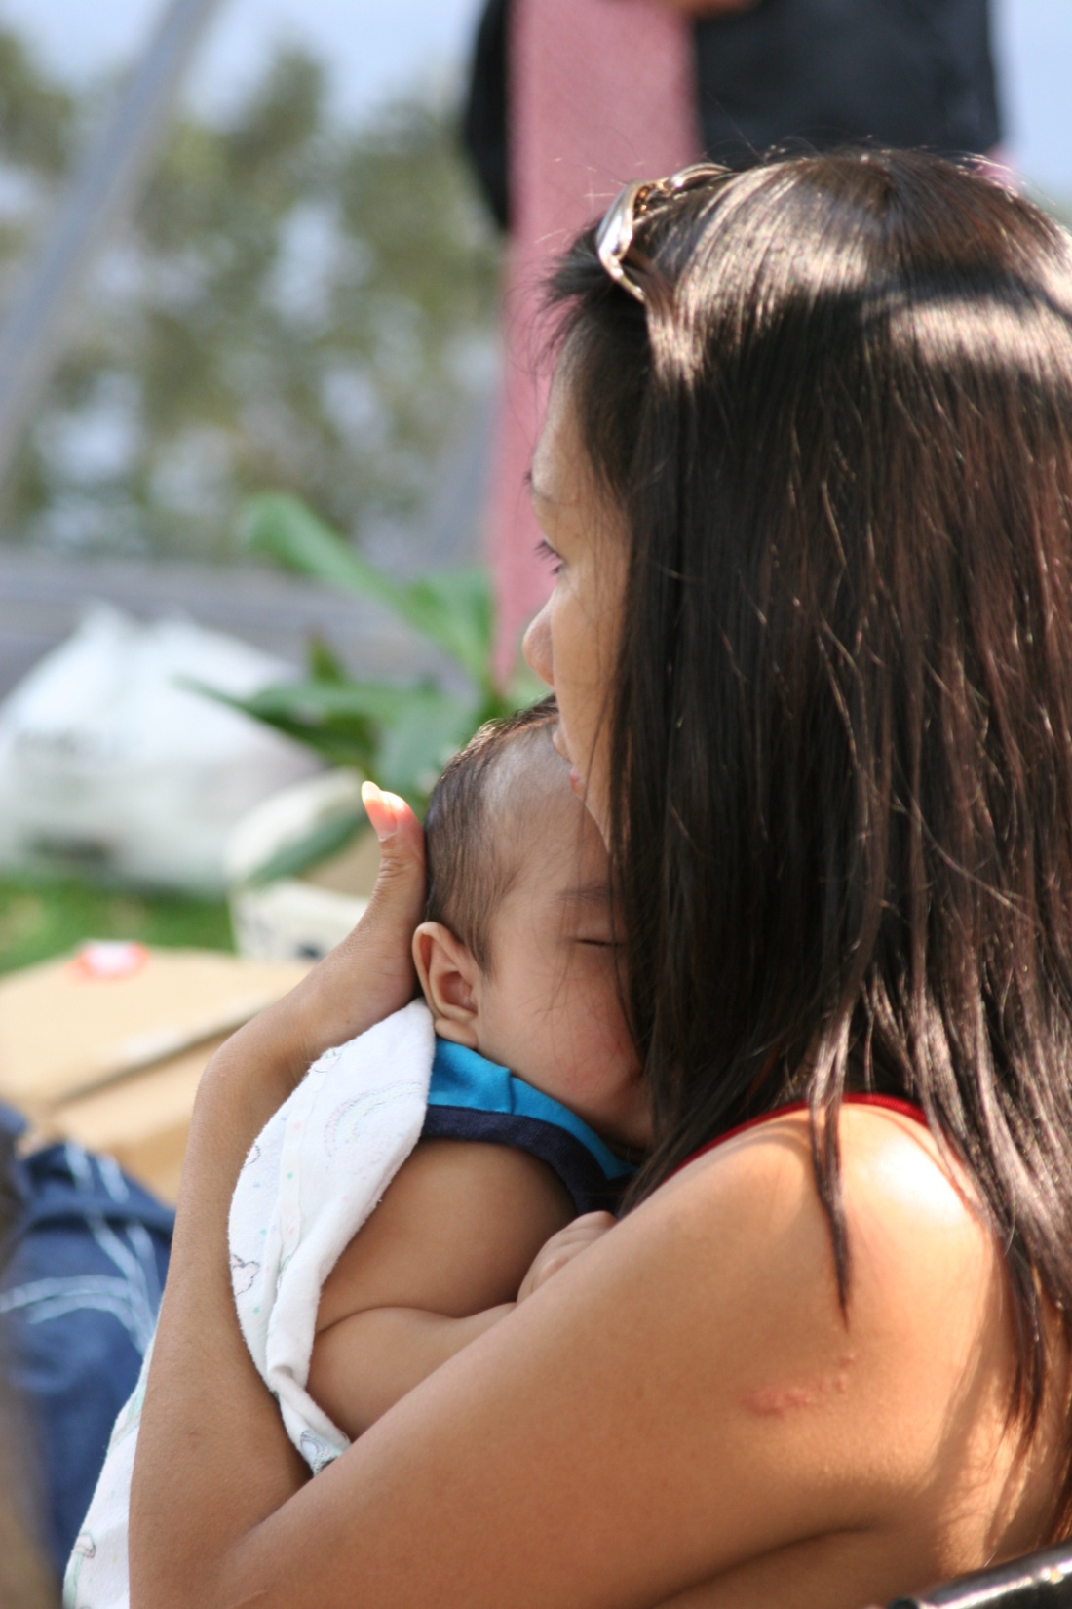
Growing (3X)
50%
< 25
Notes:
It is a very young population, with more than 50% under 25.

Slide 7
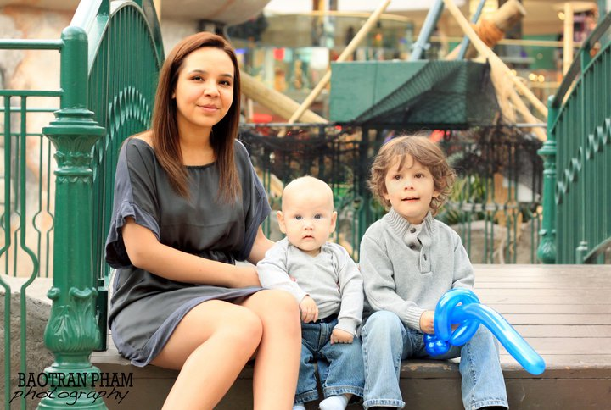
Growing (3X)
Young (<25)
Urban(+)
Notes:
The Aboriginal population of Canada is becoming more urban.

Slide 8

Mobile
Growing (3X)
Young (<25)
Urban (+)
Notes:
In Alberta, 59% of First Nations people live off reserve, and of those people, 48% live in either Calgary or Edmonton. Our First Nations, Métis and Inuit population is a very mobile population, with students moving back and forth between urban centres and provincial schools, band-controlled or federal schools, or schools on Métis settlements.

Slide 9
Alberta High School Completion Rate
Notes:
The high school completion rate for First Nations, Métis and Inuit students is a concern and is being addressed. All stakeholders have a part in addressing this concern.

Slide 10
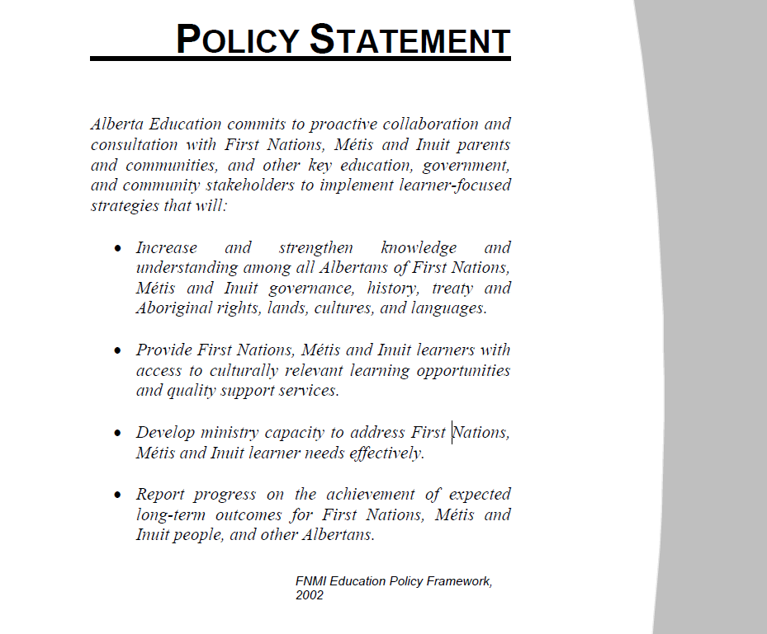
Education Business Plan 2011-2014
Goal Three: Success for First Nations, Métis and Inuit students
The outcomes expected for Goal Three are that First Nations, Métis and Inuit (FNMI) students are engaged in learning and that the achievement gap between FNMI and non-FNMI students is eliminated.
Priority Initiatives:
3.1 Implement priorities and strategies identified in the FNMI Education Partnership Council Action Plan.
3.2 Implement the commitments identified in the Memorandum of Understanding for First Nations’ education in Alberta.
3.3 Attract and retain increased numbers of FNMI professionals in the education workforce.
Notes:
Alberta Education has had First Nations, Métis and Inuit student achievement as a focus since 1985 with the publication of Native Education in Alberta Schools. In 2002, Alberta Education created the FNMI Policy Framework, which eventually led to Goal Three of the 2011–2014 Education Business Plan: “Success for First Nations, Métis and Inuit students.”

Slide 11
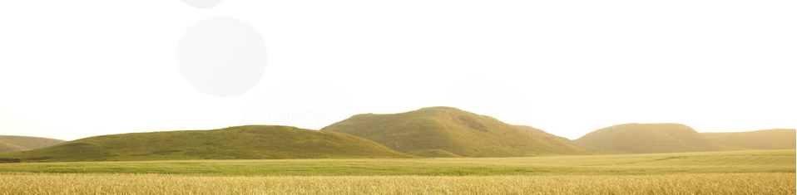
Education Ministry
Students
Teachers
Jurisdiction
School
Notes:
In the education system our goal is success for every student through collaboration education. In order for our First Nation, Métis and Inuit students to achieve success, we need to meet their needs. It is believed that to best address the needs of our First Nations, Métis and Inuit population, we need to learn more about these diverse cultures. The Walking Together resource was created and designed to guide teachers, administrators and school boards as they seek to find ways to incorporate First Nations, Métis and Inuit content, perspectives and ways of knowing into their classrooms, schools and jurisdictions.

Slide 12
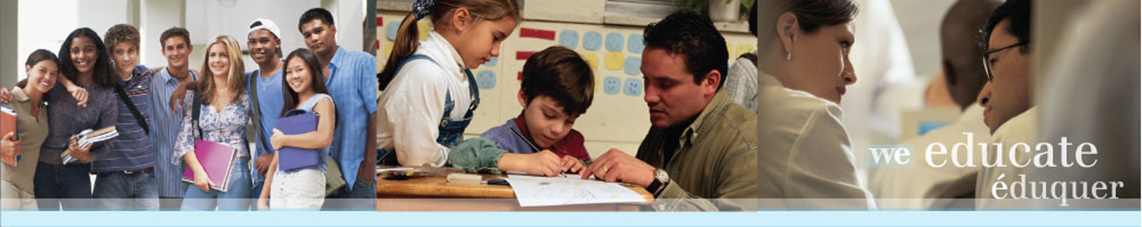
Who is
THE INTENDED AUDIENCE?
Notes:
This resource is for the intended use of teachers, administers and adult stakeholders; it is not intended for classroom use or student instruction.

Slide 13
The Intent
Increase appreciation and understanding of First Nation, Métis and Inuit diversity.
Strengthen confidence in the weaving of First Nation, Métis and Inuit content, perspectives and experiences.
Encourage and support Indigenous pedagogy.
Administrators Parents/Guardians
Teachers Education Stakeholders
Community members
Notes:
The resource was created for use by administrators, teachers, community members, parents/guardians and education stakeholders.
It is hoped that that the resource will
increase teachers’ understanding of the expertise and knowledge held within the rich and diverse First Nation, Métis and Inuit cultures in Alberta
strengthen teachers’ confidence to include and weave First Nation, Métis and Inuit content, perspectives and experiences into their daily instruction
encourage teachers to explore teaching and learning from an Indigenous perspective

Slide 14
Talking about Aboriginal culture is equivalent
to talking about Asian, European or African culture.
Each of these broad categories contains countless cultures, and each displays an incredible variety of customs, traditions, languages and perspectives.
Notes:
There is so much diversity within First Nation, Métis and Inuit communities across Alberta.
There are 45 First Nation communities across 140 reserves located within the three major treaty areas of Alberta.
Treaty 6 area is in the middle of the province, Treaty 7 in the south, and Treaty 8 in the north.
There are 8 Métis Settlements and many more urban and rural Aboriginal communities.
Each of these groups has its own unique history, languages, cultural practices and spiritual beliefs.

Slide 15
How is this resource
ACCURATE, AUTHENTIC
AND APPROPRIATE?
Notes:
From the first planning stages of this resource, the goal has been to be accurate, authentic and appropriate.

Slide 16
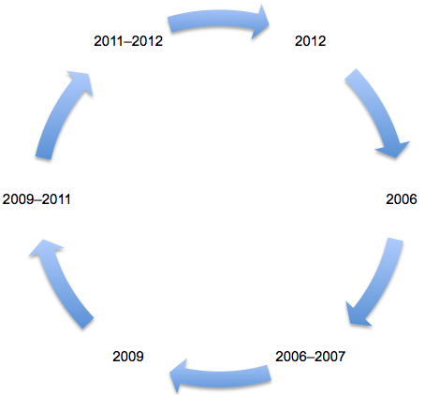
Consultation Cycle
Stage 5: Verification
The draft resource is shared with First Nation, Métis and Inuit community members and contributors for review of authenticity and accuracy.
Stage 6: Maintenance
Consultation with First Nation, Métis and Inuit community members continues in order to ensure that resource content is culturally authentic and historically accurate.
Stage 4: Development
Collaborative development of the resource proceeds with contributions from First Nation, Métis and Inuit community members.
Stage 1: Initiation
First Nation, Métis and Inuit community representatives suggest the establishment of a culturally authentic and historically accurate resource to help educators understand First Nation, Métis and Inuit perspectives.
Stage 3: Planning
A program plan is presented to the First Nation, Métis and Inuit Advisory Committee for feedback and suggestions.
Stage 2: Research
Consultation with First Nation, Métis and Inuit community representatives across Alberta results in development of topic areas and gathering of resource content.
Notes:
The consultation cycle is unique to this project.

