Slide 1
Walking Together First Nations, Métis and Inuit Perspectives in Curriculum
A Professional Development Resource
Notes:
This resource is response to calls for support in weaving First Nation, Métis and Inuit content, perspectives and experiences into the Alberta curriculum.
This resource is intended to be used by teachers, administrators, parents/guardians and stakeholders in enhancing their knowledge and understanding of First Nation, Métis and Inuit content, perspectives and experiences.
This resource will provide a working foundation of First Nation, Métis and Inuit topics, issues, cultures and ways of knowing.
Throughout the resource are personally meaningful perspectives and experiences from members of various First Nation, Métis and Inuit communities across Alberta.
The contributing members truly wanted to share their knowledge, experiences and wisdom in a spirit of enhancing the education of their children and grandchildren.
However, it is important to point out that the weaving of First Nation, Métis and Inuit content, perspectives and experiences into learning experiences is intended to enhance the education of ALL children in Alberta.

Slide 2
Topic Overview
Notes:
The 12 topic areas are derived from those suggested at the initial community meetings.
These topic areas were chosen with direct consultation with First Nation, Métis and Inuit focus groups and stakeholders.
While the resource is presented as 12 topics, each topic area is connected to the others in many ways and on many levels.
To reflect the indigenous pedagogy, it is highly recommended that participants begin their exploration with Worldviews and proceed in a clockwise fashion.

Slide 3
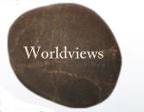
“All things are connected; all of life has purpose.”
–– Wilton Goodstriker, Kainai, Blood Tribe
Notes:
Develop an understanding of the diversity of Worldviews within First Nations, Métis and Inuit cultural and linguistic groups in Alberta.

Slide 4
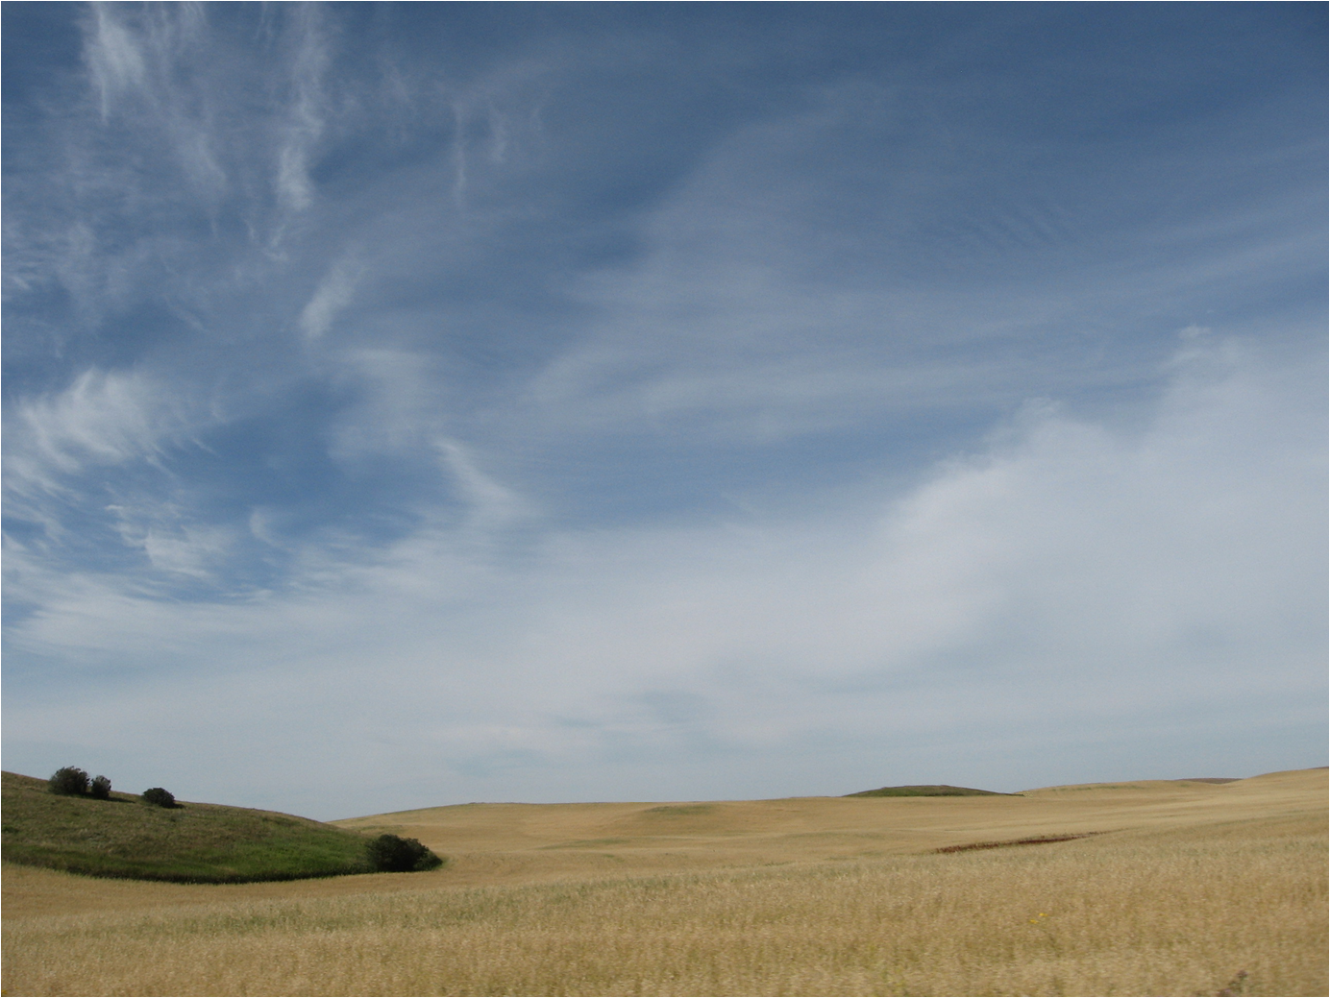
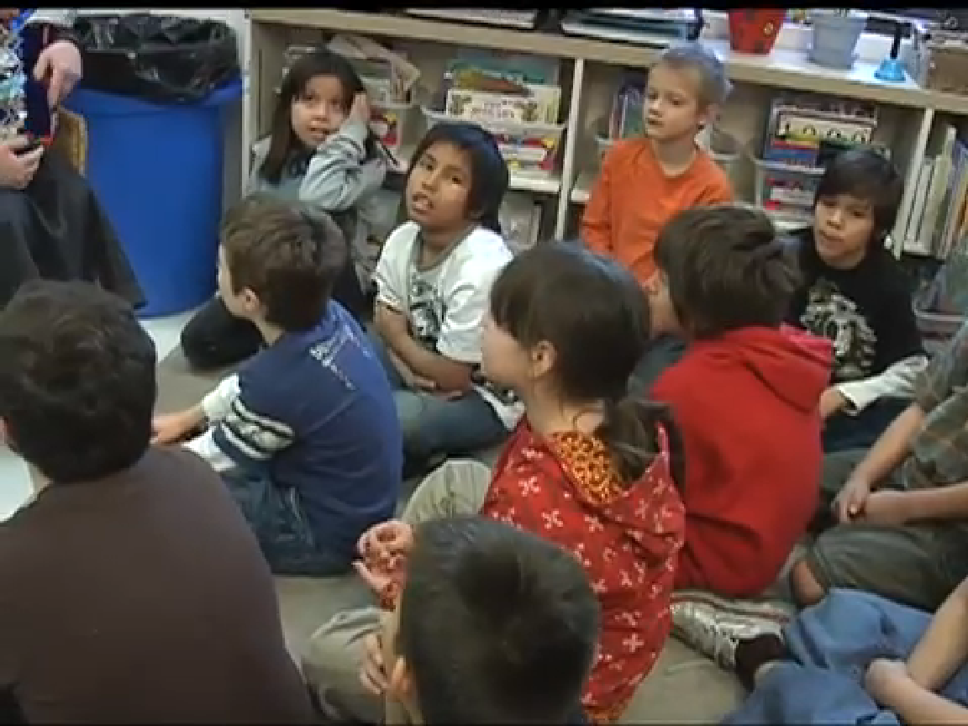
“Our stories connect us back to the land.”
–– Billy Joe Lubicon, Woodland Cree, Lubicon Lake Nation
Notes:
Develop an understanding of stories that preserve and reinforce oral traditions of First Nations, Métis and Inuit across Alberta.
Stories are powerful teaching tool.
Stories pass on the richness of a culture, sometimes through meaningful teachings, details of historical events or humour.

Slide 5
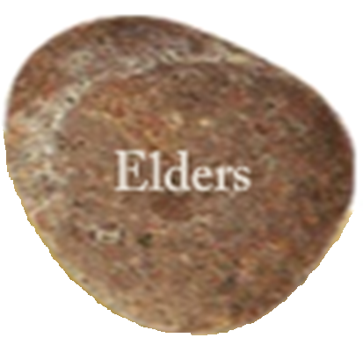
“It doesn’t have a specific age . . . there are different meanings to us for Elders.”
–– Theresa Strawberry, Saulteaux, O’Chiese First Nation
Notes:
Develop an appreciation for contributions of Elders, Knowledge Keepers and cultural advisors to promote individual and community beliefs, attitudes and values.
In First Nation, Métis and Inuit communities, Elders keep people connected to each other, their lineage and histories.
As Knowledge Keepers, Elders transmit customs and traditional practices that reveal living culture and embody a sense of identity.
In this section of the resource, you will become familiar with how Elders help their communities in many ways, from being cultural advisors to historians to social activists.

Slide 6
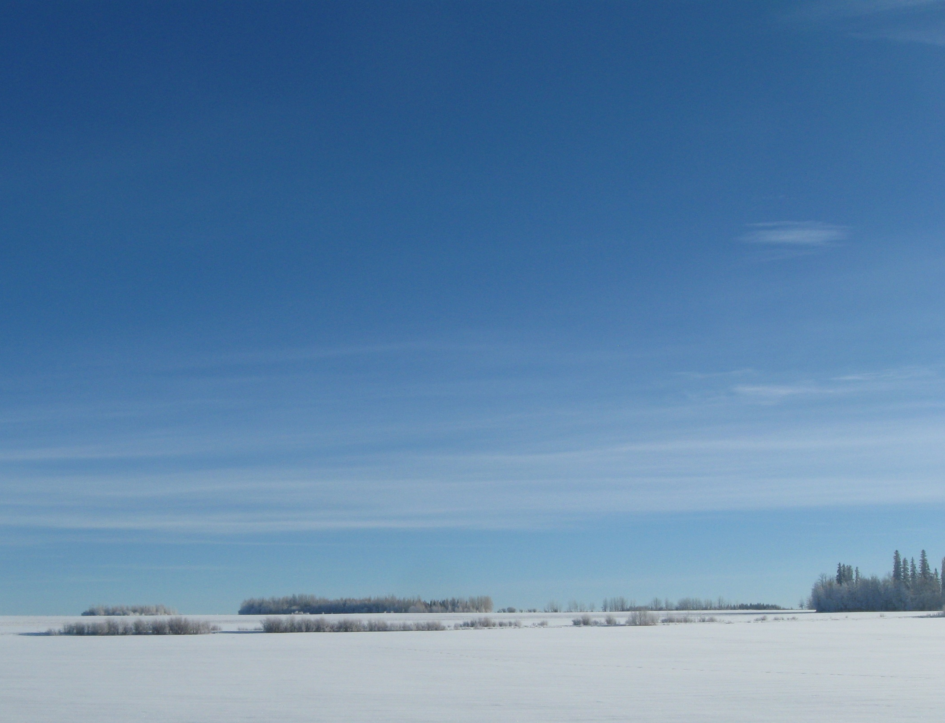
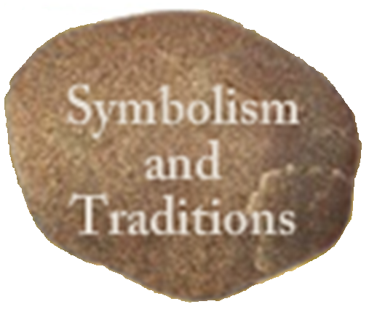
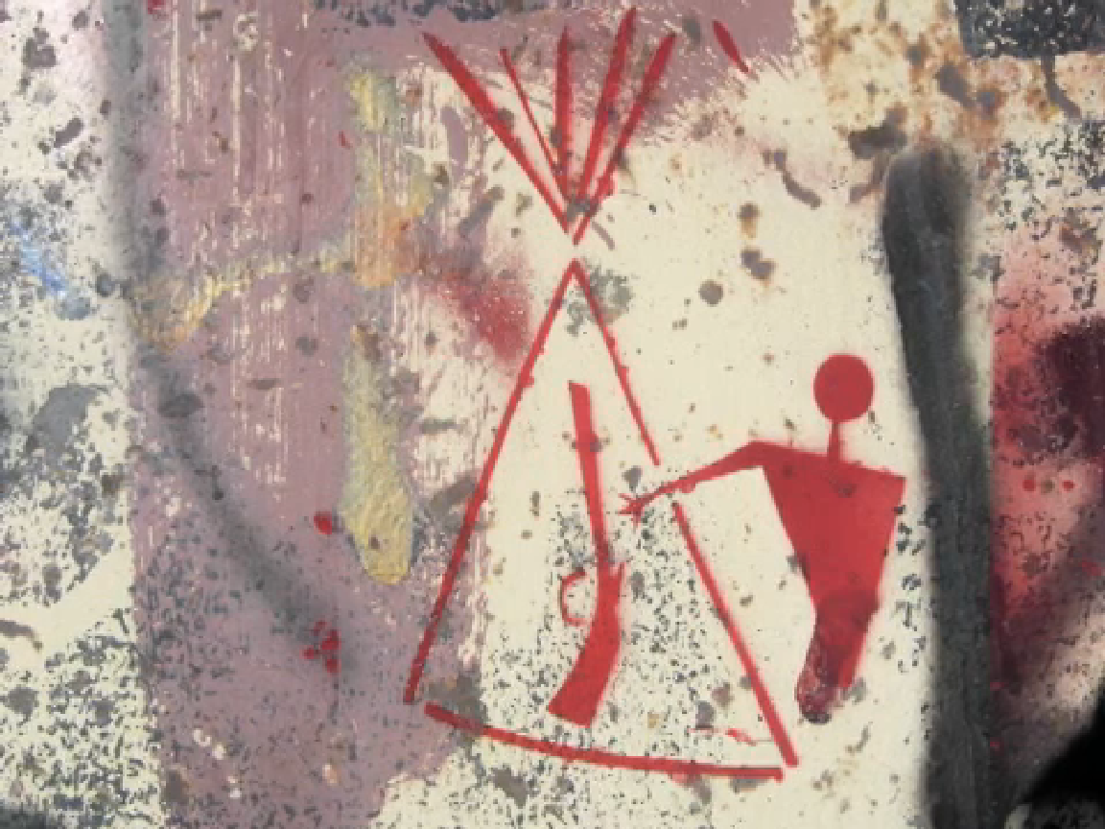
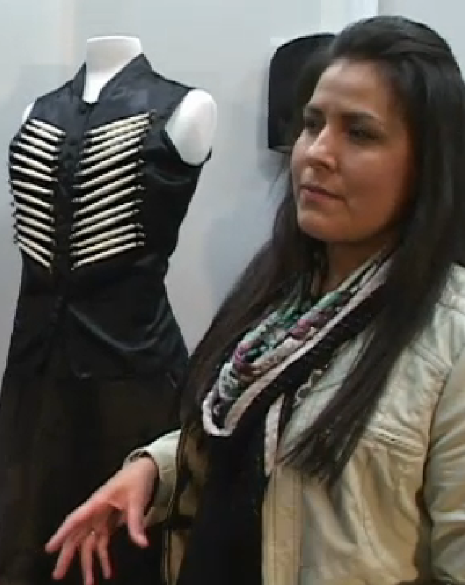
“How your culture fits in with you is really when you start discovering your true true identity, your complete identity. And everyone has a different story to tell and art is another way of telling that story.”
–– Christa Chapman, Teacher
Notes:
Develop an understanding of First Nations, Métis and Inuit cultural symbolism and traditions.
Symbols and traditions reflect the values and beliefs of a culture and its people.
Evolving over time, symbols and traditions vary among First Nations, Métis and Inuit and are central to their identity and way of life.

Slide 7
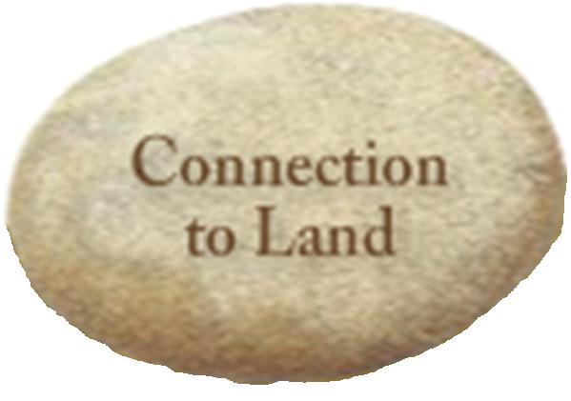
“When you go someplace and the land doesn’t do anything for you, in other words you can’t remember the songs, can’t remember the stories and so on. It’s almost as though your mother has cut ties with you…That’s when you have an ID problem.”–– Leroy Little Bear
“We will never get lost on our own land.”Patrick Eagle Plume
Notes:
Develop a holistic (physical, emotional, mental and spiritual) understanding of the connection between Inuit, Métis and First Nation peoples and the land.
For many of us, land shapes our culture, identity and sense of belonging.
This resource provides us with an opportunity to reflect upon how where we live shapes who we are.

Slide 8
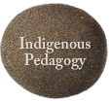
“Aboriginal tradition views the community, and thus the education system, as a living process.”
–– Our Words, Our Ways: Teaching First Nations, Métis and Inuit Learners
Notes:
To develop an understanding of traditional learning and teaching practices.
Good teaching practices are found across all societies.
Indigenous pedagogy has existed since ancient times and has endured and evolved to the present day.
Effective pedagogical practices are recognizable across every Indigenous cultural group and share many commonalities with current mainstream academia.
This section of the resource will help you to see what some of these strategies are and how you may use them in the classroom.
In the Cree language all objects are referred to either as animate or inanimate, everything has an energy and thus possesses a state of being.
Thinking within those contexts, certain physical and emotional needs must be met in order for a living system to prosper and grow.
What conditions do you believe would provide for optimal growth?

Slide 9
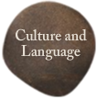
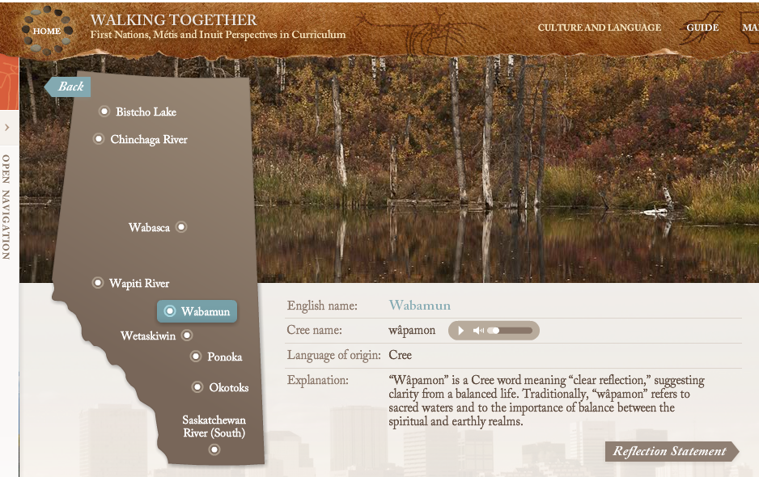
“A lot of our worldview comes from our language.”
–– Wilton Goodstriker, Kainai, Blood Tribe
Notes:
Develop an understanding of the importance of preserving First Nation, Métis and Inuit languages and cultures.
Language carries culture from the past into the present and on to the future.
In Indigenous worldviews, language and culture are interwoven with the Indigenous peoples’ connection to the land and all beings that occupy that land.
It is believed that by being able to partake in your native tongue, a person feels a deeper connection to their culture and, most importantly, to themselves.
This connection is the foundation to high self-esteem.

Slide 10
“We measure our years in ‘how many winters have you accomplished?’”
–– Narcisse Blood, Kainai, Blood Tribe
Notes:
Develop an understanding of the ways well-being is promoted by connecting traditional practices and social foundations.
In First Nation, Métis and Inuit worldviews, well-being is achieved throughout living a balanced life.
The concept of balance refers to all aspects of our being: spirit, mind, heart and body.
Indigenous peoples have long gathered throughout the changing seasons to commemorate and celebrate occasions based on this belief in balance.
In this section of the resource an understanding of this importance is described and modelled.
Canadian winters are not usually mild.
For most of us, we think about our winters as being frigid, barren, dark and long.
Now imagine hundreds, if not thousands, of years ago.
Our eye view of winter seems temperate.
In order to survive a Canadian winter, one would really have to be well equipped body, mind and spirit.
It is no wonder that accomplishment is counted by how many winters one has triumphed over.

Slide 11
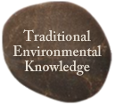
“If we are going to have a nation that respects the environment and treats nature as sacred, what stories do you think we need to be telling?”
–– David Thompson, Environmental Lawyer and Consultant
Notes:
Develop an understanding of Inuit, Métis and First Nation peoples’ perspectives on respectful use of the land and resources.
Traditional environmental practices followed by First Nations, Métis and Inuit over the ages have yielded traditional environmental knowledge (TEK), which is valued by industry, education and government.
Elders and Knowledge Keepers offer their perspectives and wisdom that can ensure a healthy environment for coming generations.
An old proverb says:
Only after the last tree has been cut down,
Only after the last river has been poisoned,
Only after the last fish has been caught,
Only then will you find out that money cannot be eaten.
These are strong words and are very relevant to today's material world.
If we are to survive along with our planet, we need to adopt a view of reciprocity: The land provides us with what we need, and therefore we must only take what we need.
In this section you will be introduced to a diverse sampling of TEK practices, as well as the contemporary perspectives that connect these teachings to the modern world.

Slide 12
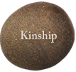
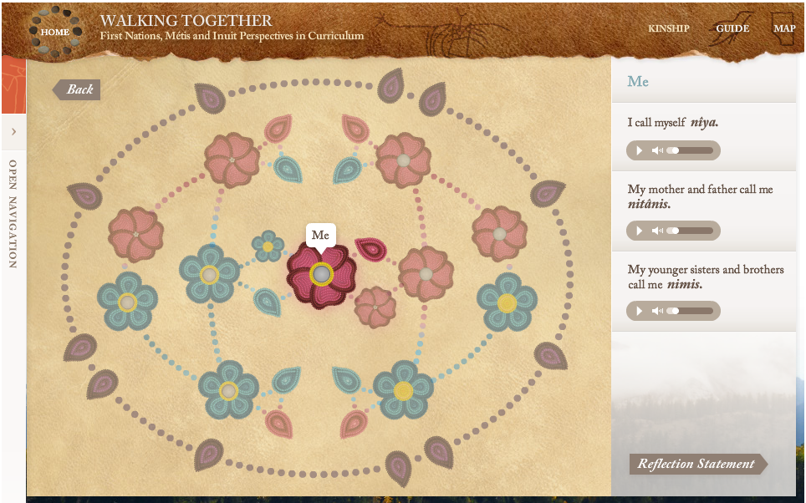
“Everyone plays a role in how a child is brought up.”
–– Narcisse Blood, Kainai, Blood Tribe
Notes:
Develop an understanding of First Nation, Métis, and Inuit perspectives of kinship systems, our connections with one another and the universe.
First Nation, Métis, and Inuit kinship systems are as complex and diverse as the nations who practise them.
Encompassing societal values and spiritual beliefs within a land-based framework, these kinship systems were established to maintain the traditional ways of life, assuring the young and elderly were cared for as well as determining the responsibility of specific work roles and the distribution of food and other resources.
Although many of kinship terms have been replaced by English ones, the extended family network remains important to Indigenous peoples and continues to apply to contemporary life.
Indigenous kinship systems really follows the belief that “it takes a community to raise a child.”
Kinship is considered one of the most important aspects of raising a child. Everything and everyone contributes to his or her upbringing.

Slide 13
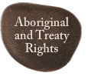
“The treaties are organic documents. They are a living agreement.”
–– Dr. Andrew Bear Robe, Siksika, Siksika Nation
Notes:
Develop an appreciation of the complex perspectives and issues related to treaties and rights.
This topic area will cover the 5 W’s of treaties and Aboriginal rights. The information will help you and your students to appreciate and understand how these treaties and Aboriginal rights affect all Canadians.
The personal reflection provided a first voice response to issues surrounding Aboriginal and Treaty rights

Slide 14
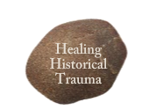
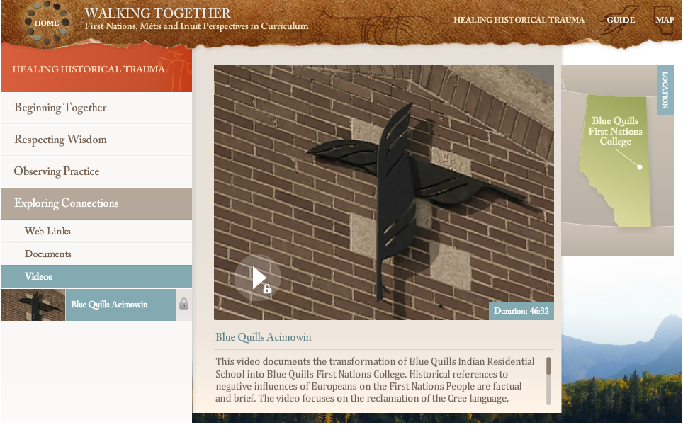
“A lot of children do not know who they are today . . . They don’t have a sense of belonging.”
–– Sykes Powderface, Chiniki Band, Stoney Nakoda Nation
Notes:
Develop an understanding of historical trauma and issues related to colonialism and imperialism
Historical events and interactions between First Nations, Métis, Inuit and the governments of the time have resulted in conflict and trauma that continue into the present.
In this topic area, we will look at six of the many significant events and policies, their multigenerational impacts, and how Inuit, First Nation and Métis peoples are moving forward toward healing.
Without a sense of belonging, one can begin to feel lost.
Reclaiming culture, language and traditions are at the forefront of helping to heal the historical trauma inflicted upon Inuit, First Nation and Métis peoples.
Building a strong sense of identity, acceptance and belonging is the key success for all students.

Slide 15
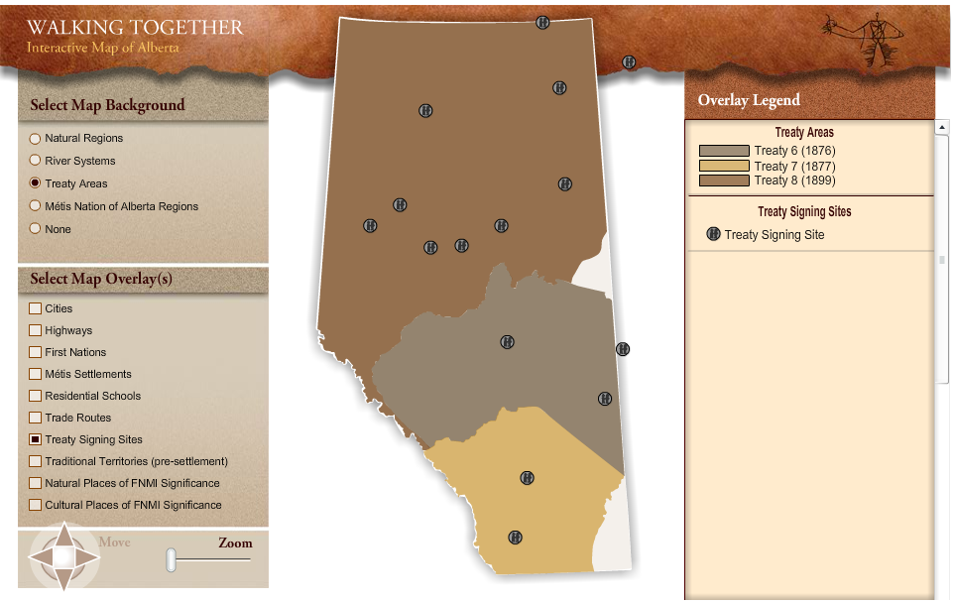
The Interactive Map
Notes:
Access the Interactive Map through the navigation bar icon.
The Interactive Map can be used to enhance exploration and discussions arising from the resource.
It is accessible from all pages containing the upper navigation bar.

